Slide 1


Lead scoring case study
Submitted By: Abhay Saxena & Roopali Misra

Slide 2
Problem Statement
To help X Education to select the most promising leads(Hot Leads), i.e. the leads that are most likely to convert into paying customers.
To build a logistic regression model to assign a lead score value between 0 and 100 to each of the leads which an be used by the company to target potential leads.
This includes:
Create a Logistic Regression model to predict the Lead Conversion probabilities for each lead.
Decide on a probality threshold value above which a lead will be predicted as converted, whereas not converted if it is below it.

Slide 3
Approach
➢Source the data for analysis
➢Clean and prepare the data
➢Exploratory Data Analysis.
➢Feature Scaling
➢Splitting the data into Test and Train dataset.
➢Building a logistic Regression model and calculate Lead Score.
➢Evaluating the model by using different metrics -Specificity and Sensitivity or Precision and Recall.
➢Applying the best model in Test data based on the Sensitivity and Specificity Metrics.

Slide 4
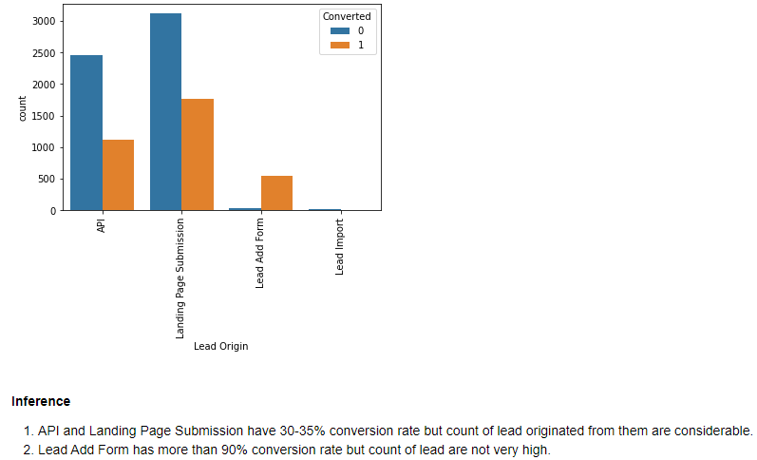
EDA: Based on lead origin

Slide 5
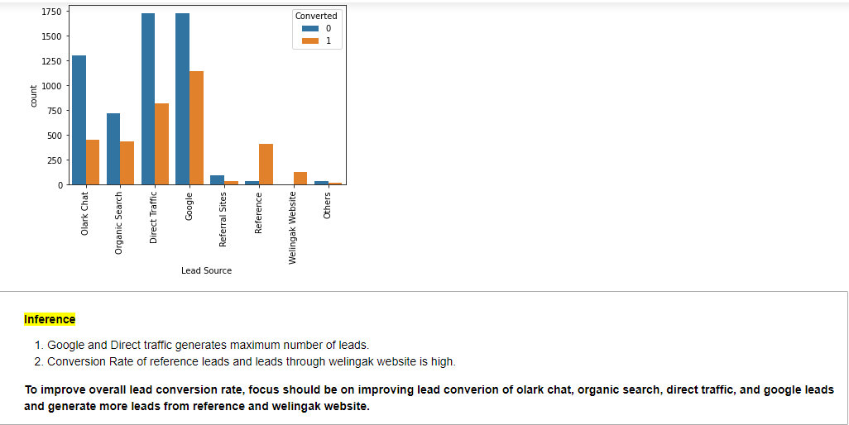
EDA: Based on lead source

Slide 6
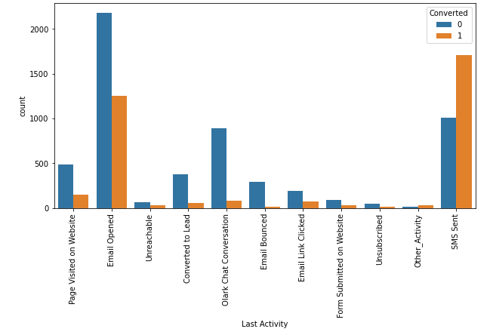
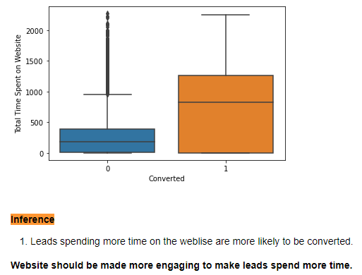
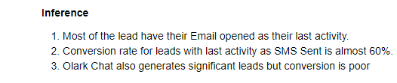
EDA: Based on time spend on website and last activity

Slide 7
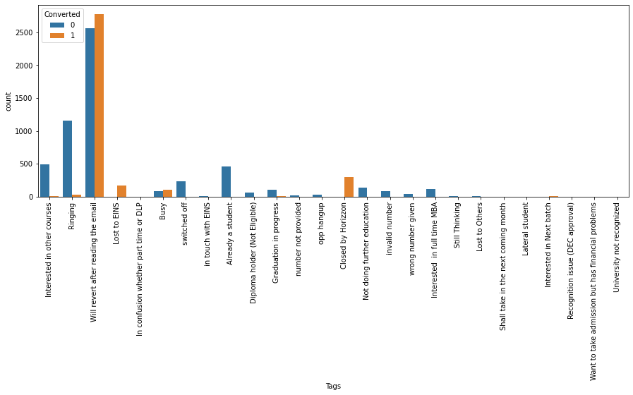
EDA: Based on tags

Slide 8
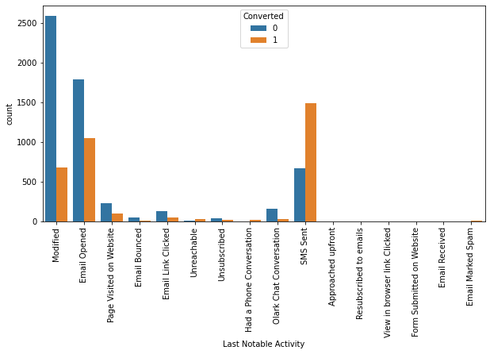
EDA: Based on Last Notable Activity
Most of the lead have their Email opened as their last activity.
Conversion rate for leads with last activity as SMS Sent is almost 60%.
Olark Chat also generates significant leads but conversion is poor

Slide 9
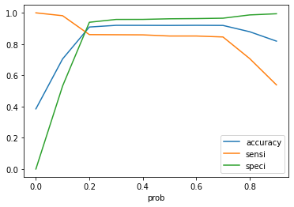
Model Evaluation -Sensitivity and Specificity on Train Data Set
•Accuracy-90%
•Sensitivity-86%
•Specificity-93%
•FalsePositiveRate-6%
•PositivePredictiveValue-89%
•NegativePredictiveValue–91%

Slide 10
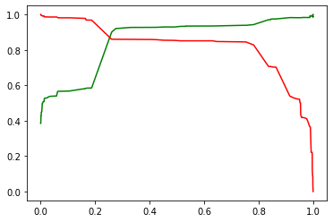
Model Evaluation –Sensitivity and Specificity on Test Dataset
[[3756, 149],
[ 363, 2083]]
Precision: 93% Recall: 85%
[[1628, 106],
[ 154, 835]]
Accuracy: 90%
Sensitivity: 84%
Specificity: 93%

Slide 11
Thank you

